Slide 1

Sleep in Young Women with
Breast Cancer:
A Narrative Review
YSN Scholar’s Day
Youri Hwang, MSN, APRN, FNP-C
PhD Candidate
M. Tish Knobf, PhD, RN, FAAN
Professor
Notes:
Hello, everyone. My name is Youri Hwang and I’m a 3rd year PhD candidate at YSN. I’m mentored by Dr. Tish Knobf.
Today, I’ll be talking about my literature review on sleep in young women with breast cancer.

Slide 2
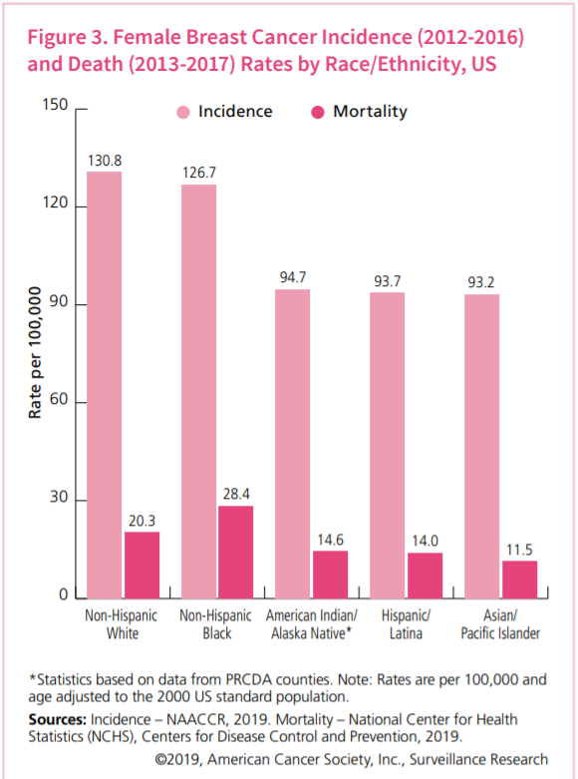
Breast Cancer Survivorship in the US
In 2020, 276, 480 new cases of invasive breast cancer diagnosed
5-year survival rate > 90%
3.8 million breast cancer survivors
Young women = sub-group of survivors
American Cancer Society. Breast Cancer Facts & Figures 2019-2020. Atlanta: American Cancer Society, Inc. 2019.
Notes:
In the United States, 1 in 8 women will have breast cancer in her lifetime. In 2020, 276K new cases of breast cancer were diagnosed. The five-year survival rate of breast cancer exceeds 90%. As more and more breast cancer patients survive and thrive, there are about 3.8 million breast cancer survivors in the US, accounting for a quarter of total US cancer survivors.
As you see in the diagram, the incidence rate of breast cancer is the highest in non-Hispanic White women followed by Non-Hispanic Black women. However, the mortality rate is the highest in Non-Hispanic Black women. Young women are a sub-group of breast cancer survivors.

Slide 3
Estimated New Breast Cancer Cases
Young Women < 50 years in 2019
Age | Ductal Carcinoma In Situ (DCIS) | Invasive | Total
< 40 | 1,180 | 11,870
40 – 49 | 8,130 | 37,150
Total | 9,310 (16%) | 49,020 (84%) | 58,330
©2019, American Cancer Society, Inc., Surveillance Research
Notes:
Breast cancer is most prevalent in women older than 50 years. However, there were around 58,000 estimated cases of newly diagnosed breast cancer in women under age of 50 years and this number account of about 20% of total breast cancer cases.

Slide 4







Young Women with Breast Cancer (YWBC) ^{2, 3}
Often delayed diagnosis
Aggressive subtypes common
Intensive cancer treatment
Treatment-induced premature menopause
May have young children at home
Concerns about future fertility
Establishing or in mid-career
Financial concerns
Partner concerns
Notes:
Young women with breast cancer is a unique subgroup of breast cancer survivors. Clinically, young women often have delayed diagnosis of breast cancer and aggressive subtypes of breast cancer are common in young women. Young women go through intensive care treatment and are likely to experience treatment-induced premature menopause.
In terms of the life course, these young women might have young kids at home might have just started a new career or they might still go to school they could be a caregiver of someone else in the family. Given all these potential stressors from the life course and clinical trajectory of cancer treatment, young women often report uncertainty and fear of cancer recurrence. And these stressors can affect one’s sleep.

Slide 5
Sleep
The human fundamental need
to perform day-to-day function
Notes:
Sleep is the human’s fundamental need to perform day-to-day function. So, it is a crucial part of our lives.

Slide 6
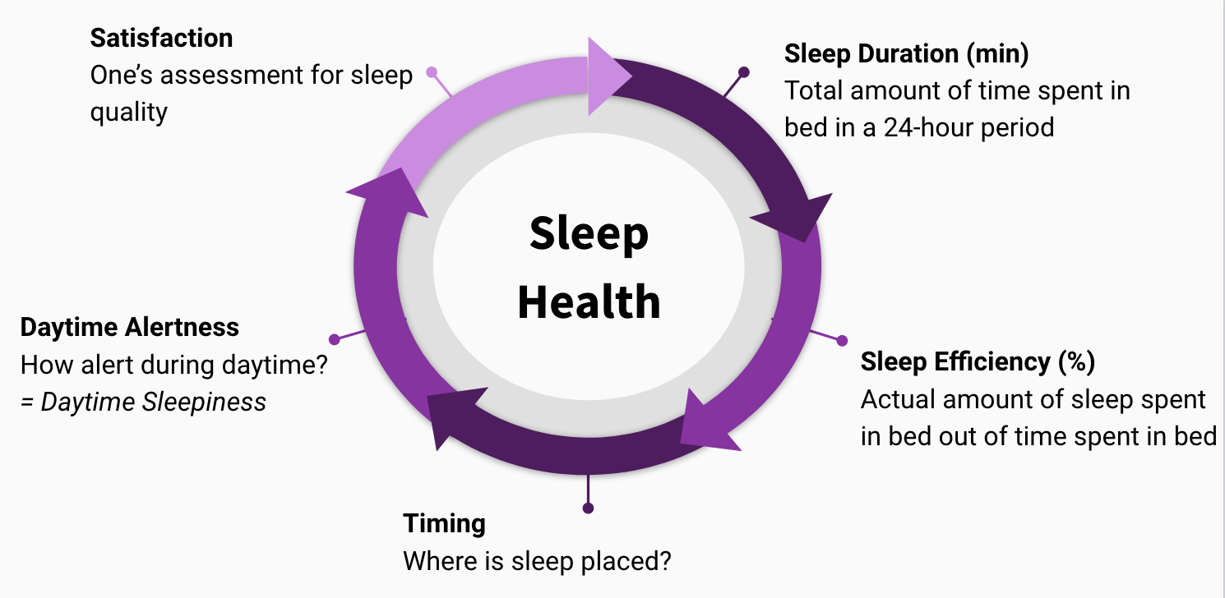
Sleep Health ⁴
Notes:
According to Buysse’s conceptual work on defining sleep health, sleep health has five dimensions including satisfaction, sleep duration, sleep efficiency, timing and daytime alertness. When these dimensions are not optimal, people experience sleep disturbance.

Slide 7

Sleep Disturbance in Breast Cancer Survivors
One of top 5 distressing symptoms
Incidence up to 65% ^{5, 6}
Persists even after treatment is over ⁷⁻⁹
Sleep disturbance is related to other symptoms, such as fatigue and depressed mood
Notes:
Sleep disturbance is one of the top-five distressing symptoms affecting up to 65% of breast cancer survivors. It persists even after cancer treatment is over affecting quality of life during survivorship. Sleep disturbance is related to other symptoms as well including fatigue, depressive symptoms and many others.

Slide 8
Knowledge Gap &
Factors Affecting Sleep YWBC
Sleep in YWBC
Physical Responses
Breast Cancer Diagnosis and Treatment
Psychological Responses
Notes:
Breast cancer diagnosis and treatment can affect one’s physical and psychological responses and these responses are potential stressors that can affect sleep. In the current literature, there is no well synthesized evidence on sleep in young women with breast cancer and no paper discusses physical and psychological response in relation to sleep disturbance.

Slide 9
Purpose of Narrative Review
Synthesize the sleep literature in YWBC
Discuss physical and psychological responses to breast cancer that may affect sleep in YWBC
Highlight gaps in our knowledge and identify the need for interventions to improve sleep outcomes in YWBC
Notes:
To fill this gap, the purpose of this review was to synthesize sleep literature in YWBC, discuss physical and psychological responses to breast cancer that may affect sleep, and highlight gaps in our knowledge and identified a need for interventions to improve sleep outcomes in YWBC.

Slide 10
Search Methods
OVID Medline, PsychINFO, Embase, Scopus
Key terms: Breast cancer AND young OR younger OR premenopausal, AND sleep OR sleep disturbance OR insomnia OR sleep problems OR sleep deficiency
Managed by Covidence
Notes:
We conducted a negative review. We searched Ovid medline, psychinfo, embase, and scopus using the following key search terms. The references were managed by a web-based reference manager, called Covidence.

Slide 11
Records after duplicates removed = 466
Studies included = 11
Notes:
This is the Prisma flow chart. There were 466 records after duplicates removed, and we included 11 studies in the review.

Slide 12
Key Findings
Age ranged between 25 – 60 years
Majority with stage 0 – III breast cancer
Sample size 42 – 505 YWBC
Sleep Measures Used
  Pittsburgh Sleep Quality Index (PSQI) (n = 4)
  Insomnia Severity Index (ISI) (n = 2)
  Medical Outcome Study Sleep Scale (MOS) (n = 1)
  Single question asking sleep disturbance (n = 4)
Notes:
The age ranged between 25 and 60 years. This was because some studies included women who were up to 10 years from diagnosis. Except for one study which included BCS diagnosed at age of 54 years, the rest included women diagnosed with breast cancer at age of 50 or younger. The majority was diagnosed with stage 0 to 3 breast cancer. A variety of sleep measures were used across to studies including the Pittsburgh sleep quality index, the insomnia severity index, and the medical outcome study sleep scale. And other studies used a single question asking about sleep disturbance.

Slide 13
Measure | Description
Pittsburgh Sleep Quality Index (PSQI) | -19 items -score ranges 0 – 21 -higher score means poorer sleep quality -measures global sleep quality -seven subscale scores (sleep quality, sleep latency, sleep duration, habitual sleep efficiency, sleep disturbance, use of sleep medications, and daytime dysfunction) -dichotomized as “good sleep” and “poor sleep” using a cut-off score of 5
Insomnia Severity Index (ISI) | -7 items -score ranges 0 – 28 -higher score means greater insomnia severity -measures severity of insomnia symptoms, satisfaction with sleep, and interference with daily functioning - 0 – 7: no clinically significant insomnia; 8 – 14: subthreshold insomnia; 15 – 21: clinical insomnia (moderate severity); 22 – 28: clinical insomnia (severe)
Sleep Scale from the Medical Outcome Study (MOS) | -12 items -score ranges 0 – 100 for 5 domains except for sleep quantity question (sleep quantity: 7 – 8 hours optimal) -higher score indicates more sleep difficulties -6 sleep dimensions (time to fall asleep, hours of sleep each night, maintaining sleep, respiratory problems, perceived adequacy of sleep, somnolence)
Notes:
As you can see in the table all these valid self-report sleep measures incorporate multiple dimensions of sleep. For example, for the Pittsburgh sleep quality index, there are seven subscales including sleep quality , sleep latency, sleep duration, sleep efficiency, sleep disturbance, use of sleep medications, and daytime dysfunction.

Slide 14
Sleep Disturbance Along with Cancer Treatment
Diagnosis
Treatment
Post-treatment
Before adjuvant chemo, PSQI was 7.4, indicating “poor sleep” ¹⁰
Immediately after adjuvant chemo, PSQI was 8.9 then decreased to 7.3 ¹⁰
During survivorship phase, PSQI was up to 7.8 ¹¹, and 82% of YWBC reported insomnia symptoms ¹²
    Insomnia Severity Index: 9.6 (subthreshold insomnia) ¹³
Notes:
Before adjuvant chemotherapy, the PSQI score was 7.4 indicating poor sleep using the cut-off score of 5. Then, immediately after adjuvant chemotherapy, PSQI peaked at 8.9. During the post-treatment survivorship period, 82% of YWBC reported insomnia symptoms. One study with 300 young women reported 9.6 of ISI score, indicative of subthreshold insomnia.

Slide 15
Sleep of YWBC: Comparison of Disturbance
No statistically significant difference in the level of sleep disturbance in older (>50 years) and younger (< 50 years) breast cancer survivors before and immediately after surgery ^{14, 15}
Significantly worse sleep disturbance in YWBC compared to older women ¹⁶
During first 5 years of survivorship, YWBC reported significantly worse sleep disturbance than other female cancer survivors ¹⁷
Notes:
Sleep disturbance was also compared with other female cancer survivors. There was no statistically significant difference in the level of sleep disturbance and younger breast cancer survivors before and after surgery. However, during the survivorship phase, young women reported significantly worse sleep disturbance than older women and other female cancer survivors.

Slide 16
Sleep Disturbance Factors ^{10, 11, 13}
Greater fatigue, depressive symptoms
Poorly differenti-ated tumor
Not fully employed
Less religious
Experience of treatment-induced menopause
High prior level of sleep disturbance
Number of children
Notes:
We also found factors associated with sleep disturbance. Those factors included greater level of fatigue and depressive symptoms, higher prior level of sleep disturbance in a longitudinal design, poorly differentiated tumor, being not fully employed, less religious, having experience of treatment included menopause and number of children.

Slide 17
Physical and Psychological Responses
Related to Sleep in YWBC
Breast Cancer
Ovarian dysfunction
Body Image
Relationships & changes in roles
Uncertainty
Sleep Disturbance
Notes:
Physical and psychological responses that can be be potential stressors affecting sleep include ovarian dysfunction from treatment, uncertainty, changes in body image and relationships and roles in young women.

Slide 18
Conclusion
Significant gap found:
  Lack of multidimensional investigation of sleep
  One intervention found that improved sleep
  Use of single question
Multidimensional investigation of sleep in YWBC
Foundation for future intervention by integrating qualitative data
Use of valid sleep measures for every dimension
  (e.g., Epworth Sleepiness Scale, Morningness-Eveningness Scale)
Notes:
In conclusion, we found a significant gap in the literature. There was lack of multidimensional investigation of sleep. We found only one intervention study that improved sleep in young women which incorporated mindfulness practice. However, there was no valid discussion on underlying mechanism that caused the improvement. Use of a single question is problematic in that the results will not inform researchers and clinicians which dimension of sleep needs to be targeted. Thus, in my own dissertation work looking at sleep health in YWBC, I plan to investigate multidimensional aspects of sleep with additional qualitative data as a foundation for future intervention. Also, I will use valid sleep measures for every dimension of sleep health.

Slide 19
Limitations
Various sleep measures
Lack of discussion on each dimension of sleep
Lack of longitudinal data
Various age ranges
Notes:
There were several limitations in the current literature. As I described earlier, there were various measures used including a single question asking about sleep disturbance. also, there is lack of longitudinal data. Age varied significantly by including women who were 10 years from diagnosis, which means these women might be experiencing different life course and stressors that will affect sleep in a different way.

Slide 20
Implications for Research & Clinical Practice
Investigate the role of social support, stress appraisal, and coping ¹⁸⁻²⁰
Need more longitudinal data
Assess multidimensional sleep with various measures
Assess sleep as part of routine survivorship care
Notes:
The fact that younger and older women had no difference in sleep disturbance during treatment, but older women experience significantly worse sleep disturbance during survivorship warrants further investigation. One of the possible explanation is that younger BCS experience significantly less social support, and use maladaptive coping. More longitudinal data are needed to find a trajectory and predictors of sleep disturbance. Also, the future research should incorporate the multidimensional aspects of sleep using various subjective and objective sleep measures. Lastly, sleep assessment should be part of routine survivorship care in YWBC.

Slide 21
References
American Cancer Society (2019) Cancer treatment & survivorship: Facts & figures 2019-2021. American Cancer Society, Atlanta, GA
Ahmad S, Fergus K, McCarthy M (2015) Psychosocial issues experienced by young women with breast cancer: The minority group with the majority of need. Current Opinion in Supportive and Palliative Care 9 (3):271-278. doi:10.1097/SPC.0000000000000162
Knobf MT (2006) The influence of endocrine effects of adjuvant therapy on quality of life outcomes in younger breast cancer survivors. Oncologist 11 (2):96-110. doi:http://dx.doi.org/10.1634/theoncologist.11-2-96
Buysse DJ (2014) Sleep health: Can we define it? Does it matter? Sleep 37 (1):9-17. doi:10.5665/sleep.3298
Beck SL, Berger AM, Barsevick AM, Wong B, Stewart KA, Dudley WN (2010) Sleep quality after initial chemotherapy for breast cancer. Supportive care in cancer : official journal of the Multinational Association of Supportive Care in Cancer 18 (6):679-689. doi:10.1007/s00520-009-0662-y
Otte JL, Davis L, Carpenter JS, Krier C, Skaar TC, Rand KL, Weaver M, Landis C, Chernyak Y, Manchanda S (2016) Sleep disorders in breast cancer survivors. Supportive Care in Cancer 24 (10):4197-4205. doi:10.1007/s00520-016-3247-6
Lowery-Allison AE, Passik SD, Cribbet MR, Reinsel RA, O'Sullivan B, Norton L, Kirsh KL, Kavey NB (2018) Sleep problems in breast cancer survivors 1–10 years posttreatment. Palliative & Supportive Care 16 (3):325-334. doi:10.1017/S1478951517000311
Otte JL, Carpenter JS, Russell KM, Bigatti S, Champion VL (2010) Prevalence, severity, and correlates of sleep-wake disturbances in long-term breast cancer survivors. Journal of Pain and Symptom Management 39 (3):535-547. doi:10.1016/j.jpainsymman.2009.07.004
Savard J, Simard S, Blanchet J, Ivers H, Morin CM (2001) Prevalence, clinical characteristics, and risk factors for insomnia in the context of breast cancer. Sleep 24 (5):583-590. doi:10.1093/sleep/24.5.583
Ho S-Y, Rohan KJ, Parent J, Tager FA, McKinley PS (2015) A longitudinal study of depression, fatigue, and sleep disturbances as a symptom cluster in women with breast cancer. Journal of pain and symptom management 49 (4):707-715. doi:10.1016/j.jpainsymman.2014.09.009

Slide 22
References
Accortt EE, Bower JE, Stanton AL, Ganz PA (2015) Depression and vasomotor symptoms in young breast cancer survivors: The mediating role of sleep disturbance. Archives of Women's Mental Health 18 (3):565-568. doi:http://dx.doi.org/10.1007/s00737-015-0504-5
Vincent AJ, Ranasinha S, Sayakhot P, Mansfield D, Teede HJ (2014) Sleep difficulty mediates effects of vasomotor symptoms on mood in younger breast cancer survivors. Climacteric 17 (5):598-604. doi:http://dx.doi.org/10.3109/13697137.2014.900745
Hall DL, Mishel MH, Germino BB (2014) Living with cancer-related uncertainty: Associations with fatigue, insomnia, and affect in younger breast cancer survivors. Supportive Care in Cancer 22 (9):2489-2495. doi:10.1007/s00520-014-2243-y
Cimprich B (1999) Pretreatment symptom distress in women newly diagnosed with breast cancer. Cancer nursing 22 (3):185-195
Kostic S, Murtezani Z, Andric Z, Ivanovic N, Kozomara Z, Kostic M, Milicic V, Kocic S (2020) Assessment of age-related influences on the quality of life of breast cancer patients before and after surgical treatment. Vojnosanitetski Pregled 77 (9):908-916. doi:10.2298/VSP180629155K
Champion VL, Wagner LI, Monahan PO, Daggy J, Smith L, Cohee A, Ziner KW, Haase JE, Miller KD, Pradhan K, Unverzagt FW, Cella D, Ansari B, Sledge GW, Jr. (2014) Comparison of younger and older breast cancer survivors and age-matched controls on specific and overall quality of life domains. Cancer 120 (15):2237-2246. doi:https://dx.doi.org/10.1002/cncr.28737
Li J, Humphreys K, Eriksson M, Dar H, Brandberg Y, Hall P, Czene K (2016) Worse quality of life in young and recently diagnosed breast cancer survivors compared with female survivors of other cancers: A cross-sectional study. International Journal of Cancer 139 (11):2415-2425. doi:http://dx.doi.org/10.1002/ijc.30370
Sumpio C, Jeon S, Northouse L, Knobf M (2017) Optimism, symptom distress, illness appraisal, and coping in patients with advanced-stage cancer diagnoses undergoing chemotherapy treatment. Oncology Nursing Forum 44 (3):384-392. doi:10.1188/17.ONF.384-392
Wonghongkul T, Moore SM, Musil C, Schneider S, Deimling G (2000) The influence of uncertainty in illness, stress appraisal, and hope on coping in survivors of breast cancer. Cancer Nursing 23 (6):422-429
Snyder KA, Pearse W (2010) Crisis, social support, and the family response: Exploring the narratives of young breast cancer survivors. Journal of psychosocial oncology 28 (4):413-431. doi:10.1080/07347332.2010.484830

Slide 23
Q & A

